Slide 2
Young Researchers/Insight Investigators
Research ‘with’ us not ‘on’ us

Slide 3
Young Researchers/
Insight Investigators
Module 1 – Youth Voice and what is research?

Slide 4
Research for Young People designed by Young People, delivered by Young People.
Enable Young People to become the “researchers” or “investigators”.
Find out what your peers think about PE and school sport.
Design an insight toolkit so you can collect info and use your findings.
Develop skills to use these tools to collect information from your peers.
Help to develop ideas on how to feed back to your school staff and school councils.
Notes:
The workshop is intended to allow the young people aged 13-18 to create their own research and interview tools and develop their skills to deliver this.
They will then go and test the tools with their peers to gather their opinions and views of PE and/or school sport. They can learn what will work in their school to engage more and different young people in meaningful experiences of PE and competitive school sport. It will also support the school staff and sports staff to create the resources to collect, analyse and present the impact PE and school sport (the School Games).

Slide 5
Youth Voice – why is it important?
UN Convention on the Rights of the Child (UNCRC)
UN Convention on the Rights of the Child (UNCRC)
Article 12 . Every child and young person has the right to express his or her views freely in all matters affecting them
Article 13. Every child and young person has the right to freedom of expression, including the right to all kinds of information and ideas.
Notes:
Your lived experiences of being a child or young people is REALLY important to the questions we have about the PE and school sport. If research is missing your key contributions then it is not fit for purpose. The UN Convention on the Rights of the Child (UNCRC) has paved the way to encourage young people’s leadership and participation in research.

Slide 6
Youth Voice- why is it important?
Notes:
Why is youth voice important?
Show this video:
https://www.brut.media/us/international/5-young-people-changing-the-world-0705e105-78bf-455e-8824-aaed299e8479
Guide Young People to draw or write why they think it is important to hear the voice of young people? Discuss or use a white board to share ideas……
Video – Keziah’s Story https://www.youtube.com/watch?v=Mi2OL0ASlgc&ab_channel=YouthSportTrust
Video – Charlie’s Story https://www.youtube.com/watch?v=tVJA-EpNTcM

Slide 7
What is Research?
Study or investigation that aims to find new information or reach a new understanding about a certain topic.
Notes:
So lets go onto what you will be doing today – you are going to become researchers – but what is research?
Draw or write down what you think – can be words to describe.

Slide 8
But I’m not a researcher?
Notes:
Activity - Using your red or green spots on wall (or chat box get them to write R or G – or get young people up and active (with a red meaning stand up and green sit down):
Who likes to eat breakfast? Green for yes, red for no – record number of no’s
Who had breakfast this morning? Green for yes, red for no – record number
For the reds discuss – What stopped you from having breakfast this morning?
For the greens discuss - What motivated you to have breakfast this morning
Get feedback from reds on barriers
Get feedback from greens on motivations
This short activity show 3 things:
How quickly and easily I can gain hard data (on the number of people who like breakfast and who actually had breakfast that morning.
Better understanding of qualitative information - the barriers & motivations and what would encourage people who don’t eat it to eat it. Opportunity to talk further to reds to better understand how to overcome their barriers and understand their motivations
If I only ever listen to the greens i.e the people who take part in breakfast, I will never understand what I can do to persuade or help the reds to eat breakfast.
Bringing this back to PE and school sport. How is this relevant to what we are trying to do?
Aim to avoid only talking to the same young people who enjoy PE and come to all the school sport competitions and activities. So if we want to attract those who are currently not engaged in PE or taking part in school sports competitions and festivals we need to understand why!

Slide 9
Why is Peer to Peer research better?
Students feel more comfortable and open.
Young people understand each other better as they share a similar lived experiences.
Empowers young people to be in more control of what is being designed in PE and school sport for them.
Young people are experts on youth issues.
Freer talking about issues to people of their own age compared to adults.
Notes:
Why is Peer to peer research better?
Informants will feel more comfortable and free talking about issues to people of their own age compared to adults. Therefore, young people can collect information about young people that is more close to the truth (more reliable) – youth participation could lead to an improvement of the quality and relevance of the research data.
The data will inform project activities (interventions) that fit better with young people’s issues and interests
Building research skills in young people has an empowering effect on young people: Their self confidence to talk about sensitive issues with peers and adults. Their understanding of social issues that negatively influence young people’s involvement in PE and school sport. Their motivation to contribute to changing things for the better
Research skills are useful social skills and good for future job opportunities.
It can help build cooperation between young people and adults: It can improve mutual respect. Adults will take young people more seriously when they are involved in research and decision-making processes. Young people will take adults more serious if they understand the challenges of their work. This can lead to more youth participation in PE and school sport.
Adapted from (Manual for young people to train as researchers | building block, 2013 )

Slide 10
What’s is it for me?
What do you think you will gain from being involved in this?
What is in it for you?
Write it down or draw what you think.
Throw a ‘stone’ in the pond and read out what statement your ‘stone’ lands on.
Notes:
This can be done with paper face to face or virtually online
F2F:
On a piece of paper write down your reason to be involved.
•Place your piece of paper in the pond (hula hoop or circle made with skipping ropes)
•Pick your own bean bag or counter (pebble) and throw it in the pond.
•Whichever piece of paper it lands on or nearest - look at that person’s reason – share it by reading it out aloud.
•What do you notice about the answer on that piece of paper? Is it similar or different to yours?
Virtual:
On the padlet/online white board (draw a pond or image in background) - write down your reason to be involved in this (becoming a young researcher)?
Tutor to give an example by typing it on the padlet/online white board, e.g. my reason to be involved is to build my confidence and make new friends.
Look at other people’s reasons – share and discuss
What do you notice about yours and other people's answers? Is it similar or different to yours?

Slide 11
Young Researchers –
We would like you to try this…..
SURVEY – give this to at least 20 people at your school to complete – these people will already be participating in PE and/or school sport
FOCUS GROUP – with 5 people from your school who do not like PE or who have never taken part in school sport.
Don’t worry you will be taught these research skills.
Notes:
Don’t worry you will be taught the skills you need to do this!
Increased relevance of research to young people and surety that outcomes capture most effectively young peoples views and perspectives – shared agenda
Young people voicing their experience through being on the receiving end of services enables a fuller understanding of young peoples perspectives
Development of personal skills and confidence, giving opportunity to make a difference – experiencing ownership – a stepping stone to future pathways
motivates a sense of altruism - young people want to be able to contribute in order to improve services for others which provides opportunity to have fun, make new friends and bring people together to develop ideas through discussion.

Slide 12
Young Researchers/
Insight Investigators
Module 2 – Skills of a Young Researcher

Slide 13
Some Skills of a Researcher
Active listening skills
Group collaboration
Knowledge of open-ended questions
Developing empathy
Emotional Intelligence
“People really resonate with peers….word of mouth from those individuals is probably a lot stronger than word of mouth from us. It is about relevant lived experience that resonates”
Focus on Us Research
Lets Practice!

Slide 14
Active Listening
Starting sentence
“Once upon a time,
a tiny grey puppy called….”
Everyone take it in turns so that each of you can add to the story based on what the previous participant has added to the story.
This is a great demonstration of active listening.
Notes:
In small groups 4-5 (f2f or breakout rooms) – can give a lots of random words if helpful.
https://youtu.be/cSohjlYQI2A Video if you have time: TED talk - 5 ways to listen better by Julian Treasure

Slide 15
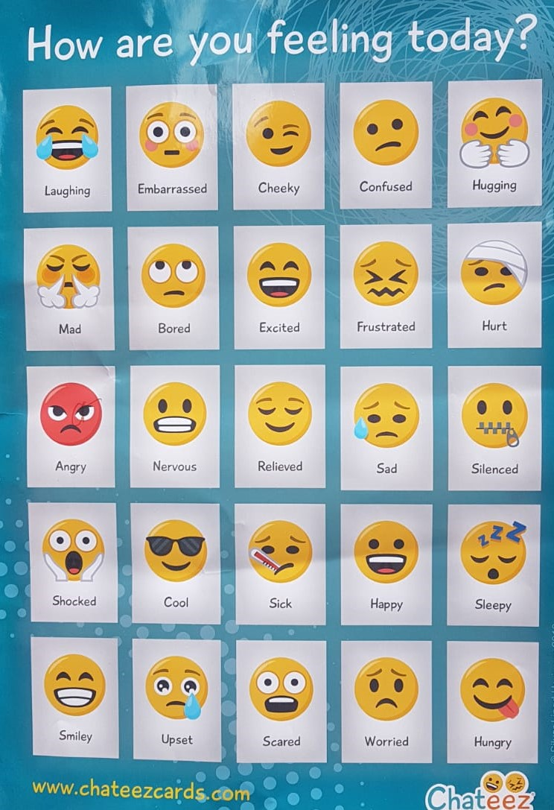
Notes:
Emotional Intelligence
Awareness of self and others; exploring empathy and understanding; Don’t make assumptions.
Ask people how they are feeling today (add to chat box online or annotate on screen) – if face to face this can be done with Chateez cards on the floor (go to the Emoji card that shows how you are feeling today)
Ask the young people to explain (if they feel they want to) on why they choose a certain emoji – don’t make assumptions!
Then ask how people feel about inclusion in PE or School sport (add to chat box online or annotate on screen) – if face to face this can be done with Chateez cards on the floor.
Facilitate a discussion around these answers

Slide 16
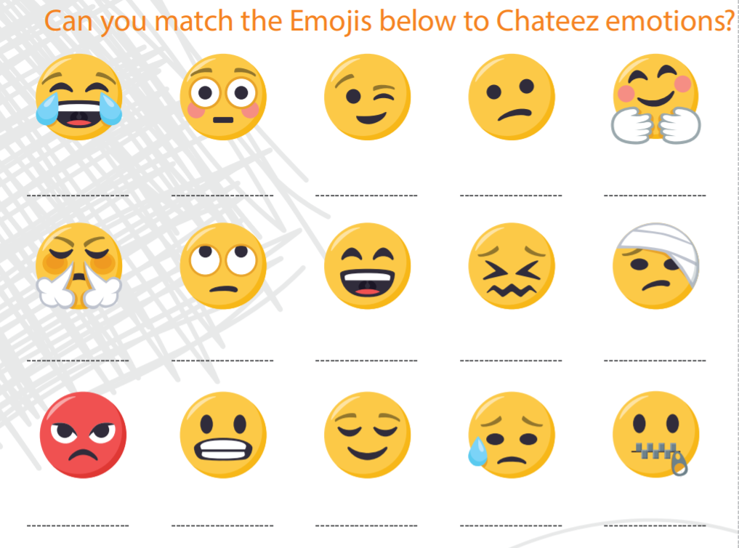
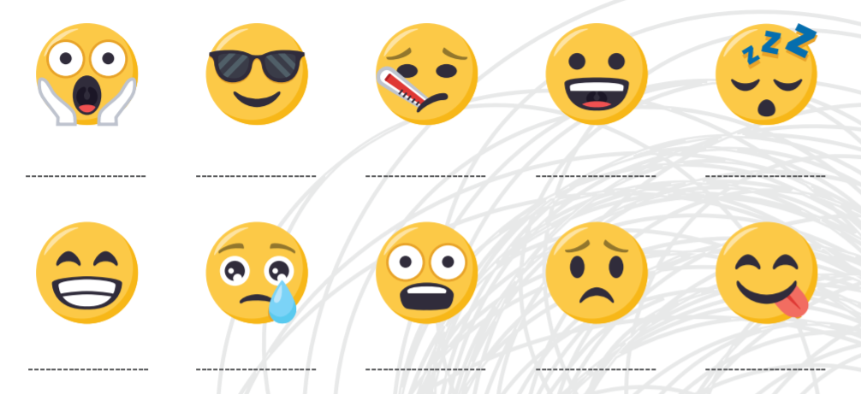
Notes:
Can you match the Emoji to the Chateez Emotions? – you can use the poster of this with post it notes if face to face or if online tutor can call out number and emotion below and young people can match using the annotate function on Zoom.
1- angry
2 – bored
3- cheeky
4-confused
5 - cool
6 -cuddly
7- embarrassed
8- excited
9-frustrated
10- happy
11-hungry
12 – hurt
13 -laughing
14 – mad
15 - nervous
16 – relieved
17- sad
18 – scared
19-shocked
20 – sick
21- silenced
22 – sleepy
23 - smiley
24- upset
25 -worried

Slide 17
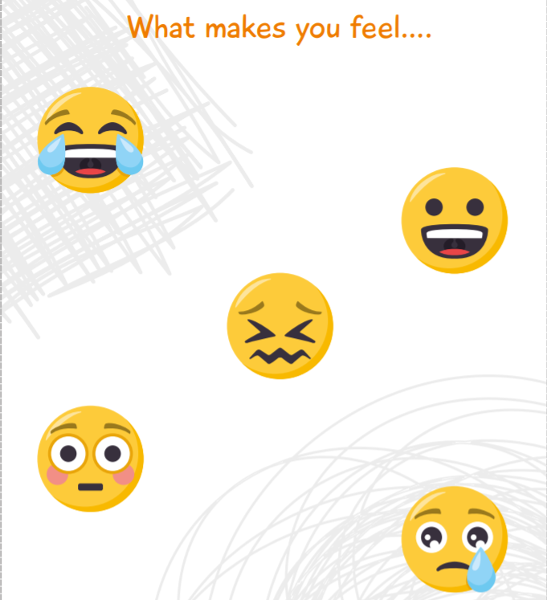
Laughing
Happy
Frustrated
Embarrassed
Upset
Notes:
Looking at Emotional Intelligence as a researcher?
If you can pair up or put in small groups get YP to take it in turns working with each other (or each person in the group) around these questions. Get YP used to asking permission to ask the questions, noting the answers and working on their research communication skills.
Or you can do this activity:
Write-out scenarios that might provoke emotion in participants.
The scenarios should be generally light emotions like forgetting your lunch, losing your phone, hearing a rumor about you, waiting for a bus, or forgetting your homework.
Each student then gets a scenario and acts it out with no speaking. After the scenario is guessed, discuss the emotional response. The more easily students can verbally express their emotions, the more easily a teacher can communicate with them and reference confusing feelings.

Slide 18
Skills and Qualities of a Researcher
What Toppings goes on YOUR pizza?
SKILLS
Ask Good Questions
Creativity
Being Organised/ Planning
Be Patient
Respect
QUALITIES
Calm
Curiosity
Commitment
Excellent communication skills
Empathy
Notes:
Think about what skills you need to be a young researcher? -you can get ideas from the list (skills and qualities of researchers).
When you have picked the 6 most important skills/qualities (toppings) for you, input them into the pizza where the labels say ‘1’ to ‘6’.
Ask the young people to now measure themselves for each slice (they can colour this in).
If filled to the outer edge this means that skill is at the most developed level (you are really good at it)
If you colour closer to the centre of the circle then that skill/quality is important and needs the most development.
(Tutor to show an example of this)
This will serve as a baseline for the young people to set their own goals aligned with the development of their own research skills and qualities – they can take real ownership of this process now.
The skills which are seen as weakest should be their development focus.
Summary:
As a young researcher you have been selected because you all possess some or all of these skills and qualities.
NB: Choose 3 of these research skills/qualities that you would like to develop. Encourage buddying up young people to support each other.

Slide 19
Different Ways to do Research…..
Survey
Focus Group
Interview
Poster Design
Observation
Photo/Picture Cards
Wordle
Polls
Vlog
StoryBoards
Notes:
Discuss different ways the can research – discuss all these different ways and maybe show examples you have of these
When you have discussed this bring back to their 2 research pieces Survey and Focus Group – what will work best in your area? Can you adapt some of these ideas into your survey or focus group. What ways can you adapt those using these examples?

Slide 20
Start with why
Why is your research important?
Why is it important to design and deliver an inclusive survey and an inclusive focus group?
How can we make sure that all our peers can understand the questions and feel comfortable to share their thought with you?
What do you want to ask in your survey or focus group?
Have a go at thinking about the questions you could ask?

Slide 21
Questions are the key
Simple opening question to encourage people to talk & feel comfortable.
Ice breaker activities or Chateez cards, can be used to encourage conversation. These questions are not usually analysed.
“Go to the emoji or picture card that best represents how you feel about physical activity or PE or the school games or school sport?”
People can draw theirs also, remember to ask why people have chosen a specific card or drawn what they have.
Notes:
Discuss different ways you can ask questions using the survey or a small focus group? Importance of planning the Qs.

Slide 22
You can use or adapt these questions
What do you think of PE/school sport?
How do you feel about having to attend PE at your school?
How do you feel about being able to attend sports sessions at your school?
What do you like best about PE/ school sport?
What do you not like about PE/school sport?
Do you think that your school is offering you the best experience in PE/sport?
How do you find out about sport in your school?
Notes:
Discuss different ways you can ask questions using the survey or a small focus group? Importance of planning the Qs.

Slide 23
You can use or adapt these questions
How often you play sport at school?
Every day, once a week, about once a month, less than once a month, other?
Name the sports/physical activity that you do?
If none, what sport /activity would you like to do? Why?
Do you play a sport with your friends/family that is not in school?
Do you have a lot of fun when playing sports?
Do you enjoy PE? Explain further your response whether it is ‘yes’ or ‘no’.
Notes:
Discuss different ways you can ask questions using the survey or a small focus group? Importance of planning the Qs.

Slide 24
You can use or adapt these questions
Are you satisfied with your PE/ sport experiences in school?
Do you have a lot of choices in PE/ sport/physical activity opportunities?
Are you happy with the opportunities to get to play sport or do PE with your friends?
Is it easy for you to play sport/take part in physical activity in school?
Do you get a lot of help from your school to get involved in sport or PE?
Does PE /school sport or physical activity give you more self-confidence?
Notes:
Discuss different ways you can ask questions using the survey or a small focus group? Importance of planning the Qs.

Slide 25
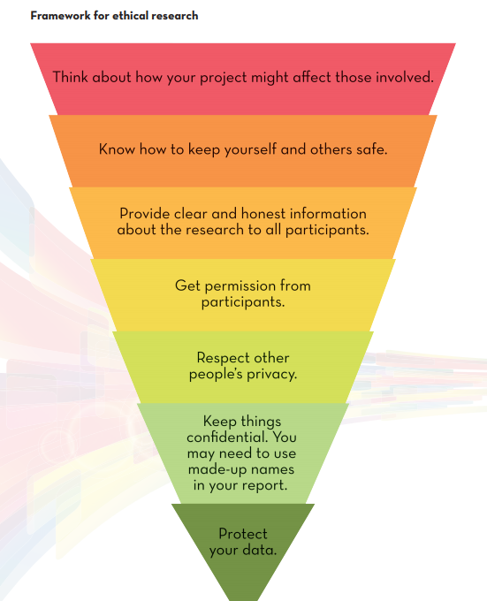
Research Ethics:
These are the correct rules of conduct to follow when carrying out your research. Following these guidelines ensures that we uphold our moral responsibility to protect research participants
(Dolan, 2015)
Notes:
Example:
Dealing with a topic that is potentially sensitive. In order to ensure that their research follows the correct ethical codes of conduct they spend time talking about how the project might affect those involved. They agree to ensure that:
• All the research participants are fully informed about what the research team are researching, why they are undertaking the research, what is involved in partaking in the research, what they will do with the findings and how they will protect individuals’ anonymity etc. • They are discreet with the data collected and keep it in a safe place where only those in the research group can access it. • They do not share the identity of the youth club staff member in the write-up of their report. • They won’t ask personal questions that are not necessary for their research.
Dolan, P. et al (2015) Youth as Researcher Training Manual. UNESCO Child and Family Research Centre

Slide 26
Analysing your Results (Dolan, 2015)
When analysing data (from questionnaires, interviews, focus groups etc.), you must look back at your research question i.e., why are you doing this research? This will help you to focus on answering the question.
Interpreting the data that you have collected
1. Put the information in perspective, e.g., compare what you found to what you expected find or previous research.
2. Consider recommendations to help improve the situation.
3. Record conclusions and recommendations.
Notes:
From: Dolan, P. et al (2015) Youth as Researcher Training Manual. UNESCO Child and Family Research Centre

Slide 27
Basic Analysis of Quantitative Information
Responses to closed-question questionnaires
1. Organise the information, i.e., add up the number of ‘yes’ responses, ‘no’ responses for each question etc.
2. Once you have completed your calculations you can create a table in excel to show the responses.
3. Illustrate your findings with graphs.
4. Write a short paragraph summarising your findings.
Notes:
Dolan, P. et al (2015) Youth as Researcher Training Manual. UNESCO Child and Family Research Centre

Slide 28
Basic Analysis of Qualitative Information
Responses from interviews, focus groups or open-questions in a questionnaire.
Look through all the responses.
Organise similar answers or comments into themes, e.g., concerns, strengths, weaknesses, similar experiences, suggestions for change etc.
Label the themes and write up what you find under each theme.
Identify any patterns in the themes,
e.g., most people were aware of…,
some of the people had concerns about…etc.
Write a short paragraph summarising findings for each category.
Illustrate your findings with powerful quotes and photos/drawings.
Notes:
Adpated from Dolan, P. et al (2015) Youth as Researcher Training Manual. UNESCO Child and Family Research Centre

Slide 29
Young Researchers –
We would like you to try this…..
SURVEY – give this to at least 20 people at your school to complete – these people will already be participating in PE and/or school sport.
FOCUS GROUP – with 5 people from your school who do not like PE or who have never taken part in school sport.
Don’t worry you will be taught these research skills.

Slide 30
Think Inclusively……….
SURVEY – How can I make sure that my survey can be understood by everyone?
Plain English, use of images to help with understanding, online versions to help students with writing difficulties.
FOCUS GROUP – How can I make sure that everyone in my focus group can understand the questions and feels heard?
Plain English questions, use of emojis/images, asking for input
from everyone (“do you have any thoughts on that Jack”)?
Notes:
Allow your young people to consider how they can make their research inclusive so everyone can understand, contribute and be heard.
Give them the link to ‘Focus on Us guidance’ to help with their focus group and ideas to go with that!

Slide 31
We would like you to try this…..
Think of 3 Questions you can ask in your survey
(people who like PE or school sport)
- why should these be different to the focus group questions?
Think of 3 Questions you can ask in your focus group
(people who do not like or engage in PE or school sport)
- why should these be different to your survey questions?
Notes:
Face to face or virtually – put young people into groups to come up with:
3 Quantitative questions they can ask for their survey (why should these be different to the focus group questions)
3 Qualitative questions they can ask for their focus group (why should these be different to the survey questions)
Optional if time: Story/Narrative/Point – what are you are trying to say/what story are you telling with your data? Do all people love PE or school sport? Or some people don’t join in because…..
10 mins

Slide 32
Call To Action!
SURVEY – give this to at least 20 people at your school to complete – these people will already be participating in PE and/or school sport.
FOCUS GROUP – with 5 people from your school who do not like PE or who have never taken part in school sport.
Work with your school staff and share your insight to them!
Notes:
Call to Action
After training: We would love you to go and collect data on the main research topics and help your school staff to make sense of it (analysis).
You and your school staff can formulate recommendations on how to improve the PE and school sport so that it meet the needs and demands of more young people.
Your school staff are here to supporting you – what top 3 things will you bring to your school staff that you are going to do? Questions and Answers

